Slide 1
Midterm Review
ISE/OR 560, Fall 2022

Slide 2
Exam Overview
75 minutes
No True/False/multiple choice questions
Calculation is not the focus, but do bring your calculator
There will be one problem (worth 20 points) that replies on you reading some materials onsite and answering related questions.
The other problems will be similar to your homework/in-class exercise.
The decision tree problem: one of the in-class textbook example with changed number

Slide 3
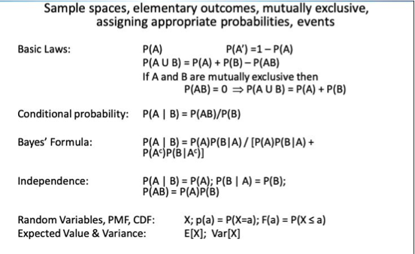

Hand-run simulation construction (will offer necessary random number)
Recognizing stochastic system vs deterministic ones
Probability

Slide 4
Decision analysis: simple EMV analysis, sensitivity analysis, value of information, decision tree.
RV Combinations: Joint Distribution Functions: CDF, pmf, pdf, covariance, independence, expectation for a function of a random variables.
Conditional Expectations: conditional probability and expectation for continuous and discrete random variables
Markov chain and exponential distribution: slides

Slide 5
Cheat Sheet
Double sides, type or written or hybrid
The first version due this Friday midnight
Put all probability formulation you do not recite in the cheat sheet
Exponential distribution formula
Markov chain formulations

Slide 6
Reading Problem
Not much to prepare

